Slide 1
Data 100 Lecture 9: Scraping Web Technologies
?
Slides by:
Joseph E. Gonzalez, Deb Nolan
deborah_nolan@berkeley.edu
hellerstein@berkeley.edu

Slide 2
Last Week …

Slide 3
Visualization
Tools and Technologies
Maplotlib and seaborn
Concepts
Length, color, and faceting
Kinds of visualizations
Bar plots, histograms, rug plots, box plots, violin plot, scatter plots, and kernel density estimators
Good vs bad visualizations
Smoothing …

Slide 4
Kernel Density Estimates and Smoothing

Slide 5
Kernel Density Estimators
Inferential statistics – estimate properties of the population
Draw conclusions beyond the data…
Descriptive Plot
Inferential Plot

Slide 6
Kernel Density Estimators
Inferential statistics – estimate properties of the population
Draw conclusions beyond the data…
Inferential Plot
Suppose this data was constructed by a random sample of student grades?
What is the probability that the next student’s grade will be between 90 and 93?
Probability of 90 < x < 93?
Area
= Area under the curve
No Data!

Slide 7
Constructing KDEs
Inferential Plot
Non-parametric Model
size/complexity of the model depends on the data:
Query
Data
Gaussian Kernel: (Commonly used → Very smooth):

Slide 8
Constructing KDEs
Non-parametric Model
size/complexity of the model depends on the data:
Inferential Plot
Gaussian Kernel: (Commonly used → Very smooth):

Slide 9
Constructing KDEs
Non-parametric Model
“Size/complexity of the model depends on the data:
Inferential Plot
Gaussian Kernel: (Commonly used → Very smooth)):
How do you pick the kernel and bandwidth?
Goal: fit unseen data
Idea: Cross Validation
Hide some data
Draw the curve
Check if curve “fits” hidden data … more on this later

Slide 11
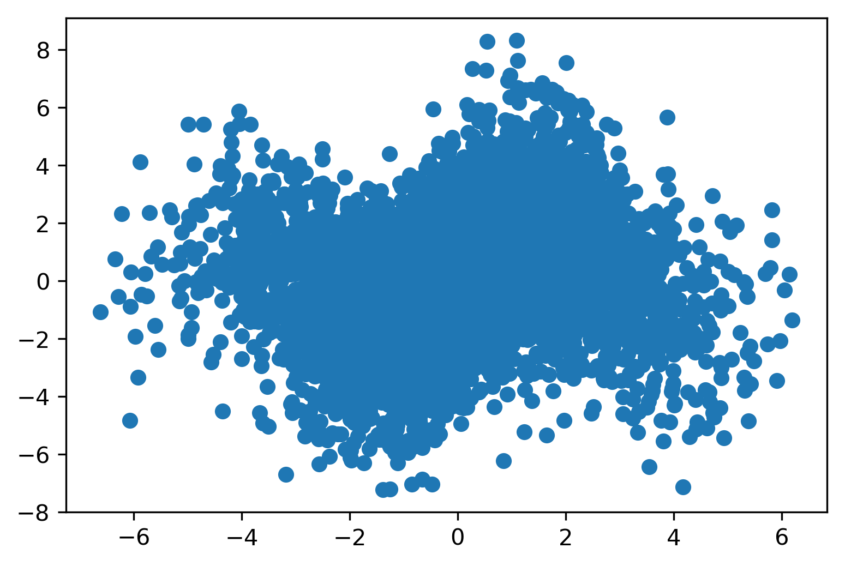
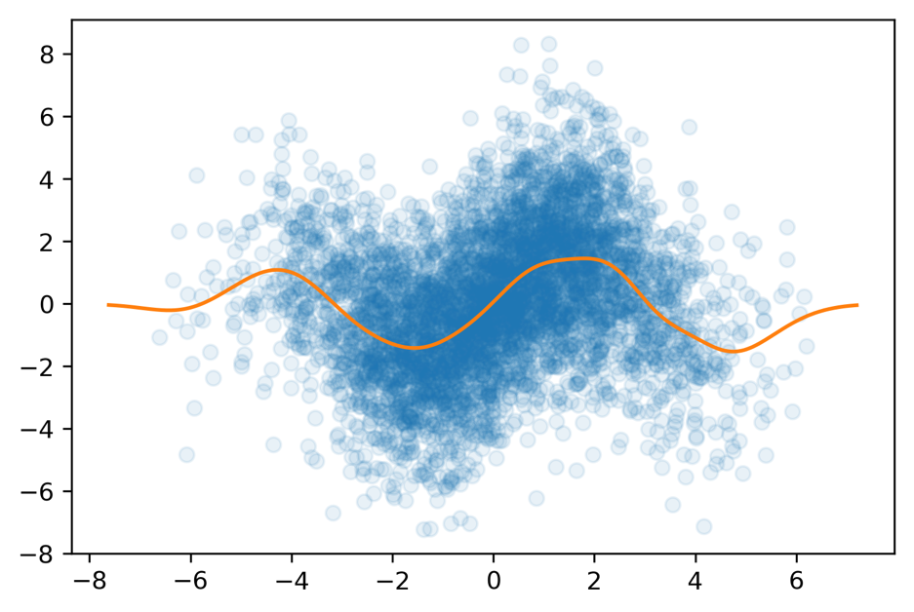
Smoothing a Scatter Plot
Descriptive Plot
Inferential Plot
Set opacity (alpha) on markers
Kernel Smoothed Fit

Slide 12
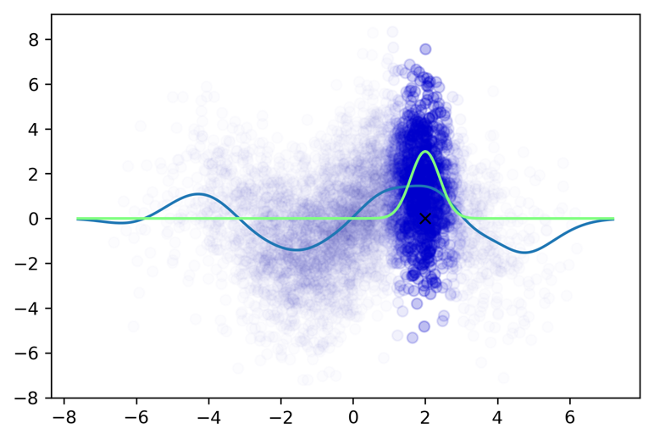
Smoothing a Scatter Plot
Weighted combination of all y values
Descriptive Plot
Inferential Plot
Set opacity (alpha) on markers
Kernel Smoothed Fit

Slide 13
Dealing with Big Data (Smoothly)
Big n (many rows)
Aggregation & Smoothing – compute summaries over groups/regions
Sliding windows, kernel density smoothing
Set transparency or use contour plots to avoid over-plotting
Big p (many columns)
Faceting – Using additional columns to
Adjust shape, size, color of plot elements
Breaking data down by auxiliary dimensions (e.g., age, gender, region …)
Create new hybrid columns that summarize multiple columns
Example: total sources of revenue instead of revenue by product

Slide 14
What’s Next …

Slide 15
This Week
Today (Tuesday)
Web technologies -- getting data from the web
Pandas on the Web
JSON, XML, and HTML
HTTP – Get and Post
REST APIs, Scraping
Thursday
Both Fernando and I are out → guest lecturer Sam Lau!!
String processing
Python String Library
Regular Expressions
Pandas String Manipulation

Slide 16
Getting Data from the Web
Starting Simple with Pandas

Slide 17
Pandas read_html
Loads tables from web pages
Looks for <table></table>
Table needs to be well formatted
Returns a list of DataFrames
Can load directly from URL
Careful! Data changes. Save a copy with your analysis
You will often need to do additional transformations to prepare the data
Demo!

Slide 18
HTTP – Hypertext Transfer Protocol

Slide 19
HTTP Hypertext Transfer Protocol
Created at CERN by Tim Berners-Lee in 1989 as part of the World Wide Web
Started as a simple request-response protocol used by web servers and browsers to access hypertext
Widely used exchange data and provides services:
Access webpage & submit forms
Common API to data and services across the internet
Foundation of modern REST APIs … (more on this soon)

Slide 20
Request – Response Protocol
Client
Server
Request
Swipe
GET /sp18/syllabus.html?a=1 HTTP/1.1
HOST: ds100.org
User-Agent: python-requests/2.18.4
Accept-Encoding: compress, gzip
Accept: */*
Header
Remaining Header Lines
Key–value pairs
Specify a range of attributes
Optional Body
send extra parameters & data
First line contains:
GET /sp18/syllabus.html?a=1 HTTP/1.1
a method, e.g., GET or POST
a URL or path to the document
the protocol and its version

Slide 21
Request – Response Protocol
Client
Server
Request
Swipe
Response
HTTP/1.1 200 OK
Server: GitHub.com
Date: Mon, 12 Feb 2018 05:41:55 GMT
Last-Modified: Mon, 22 Jan 2018 06:16:48 GMT
Access-Control-Allow-Origin: *
Content-Type: text/html; charset=utf-8
Content-Encoding: gzip
Header
First line contains status code
Key-Value Pair Lines
Data properties
Body
Returned data
HTML/JSON/Bytes
<!DOCTYPE html><html lang="en"> <head> <meta charset="utf-8"> <meta http-equiv="X-UA-Compatible" content="IE=edge"> <title>DS100</title><meta name="author" content="UC Berkeley"> <meta name="viewport" content="width=device-width, initial-scale=1.0"> <link href="/assets/themes/bootstrap/css/bootstrap.min.css"> …
Body

Slide 22
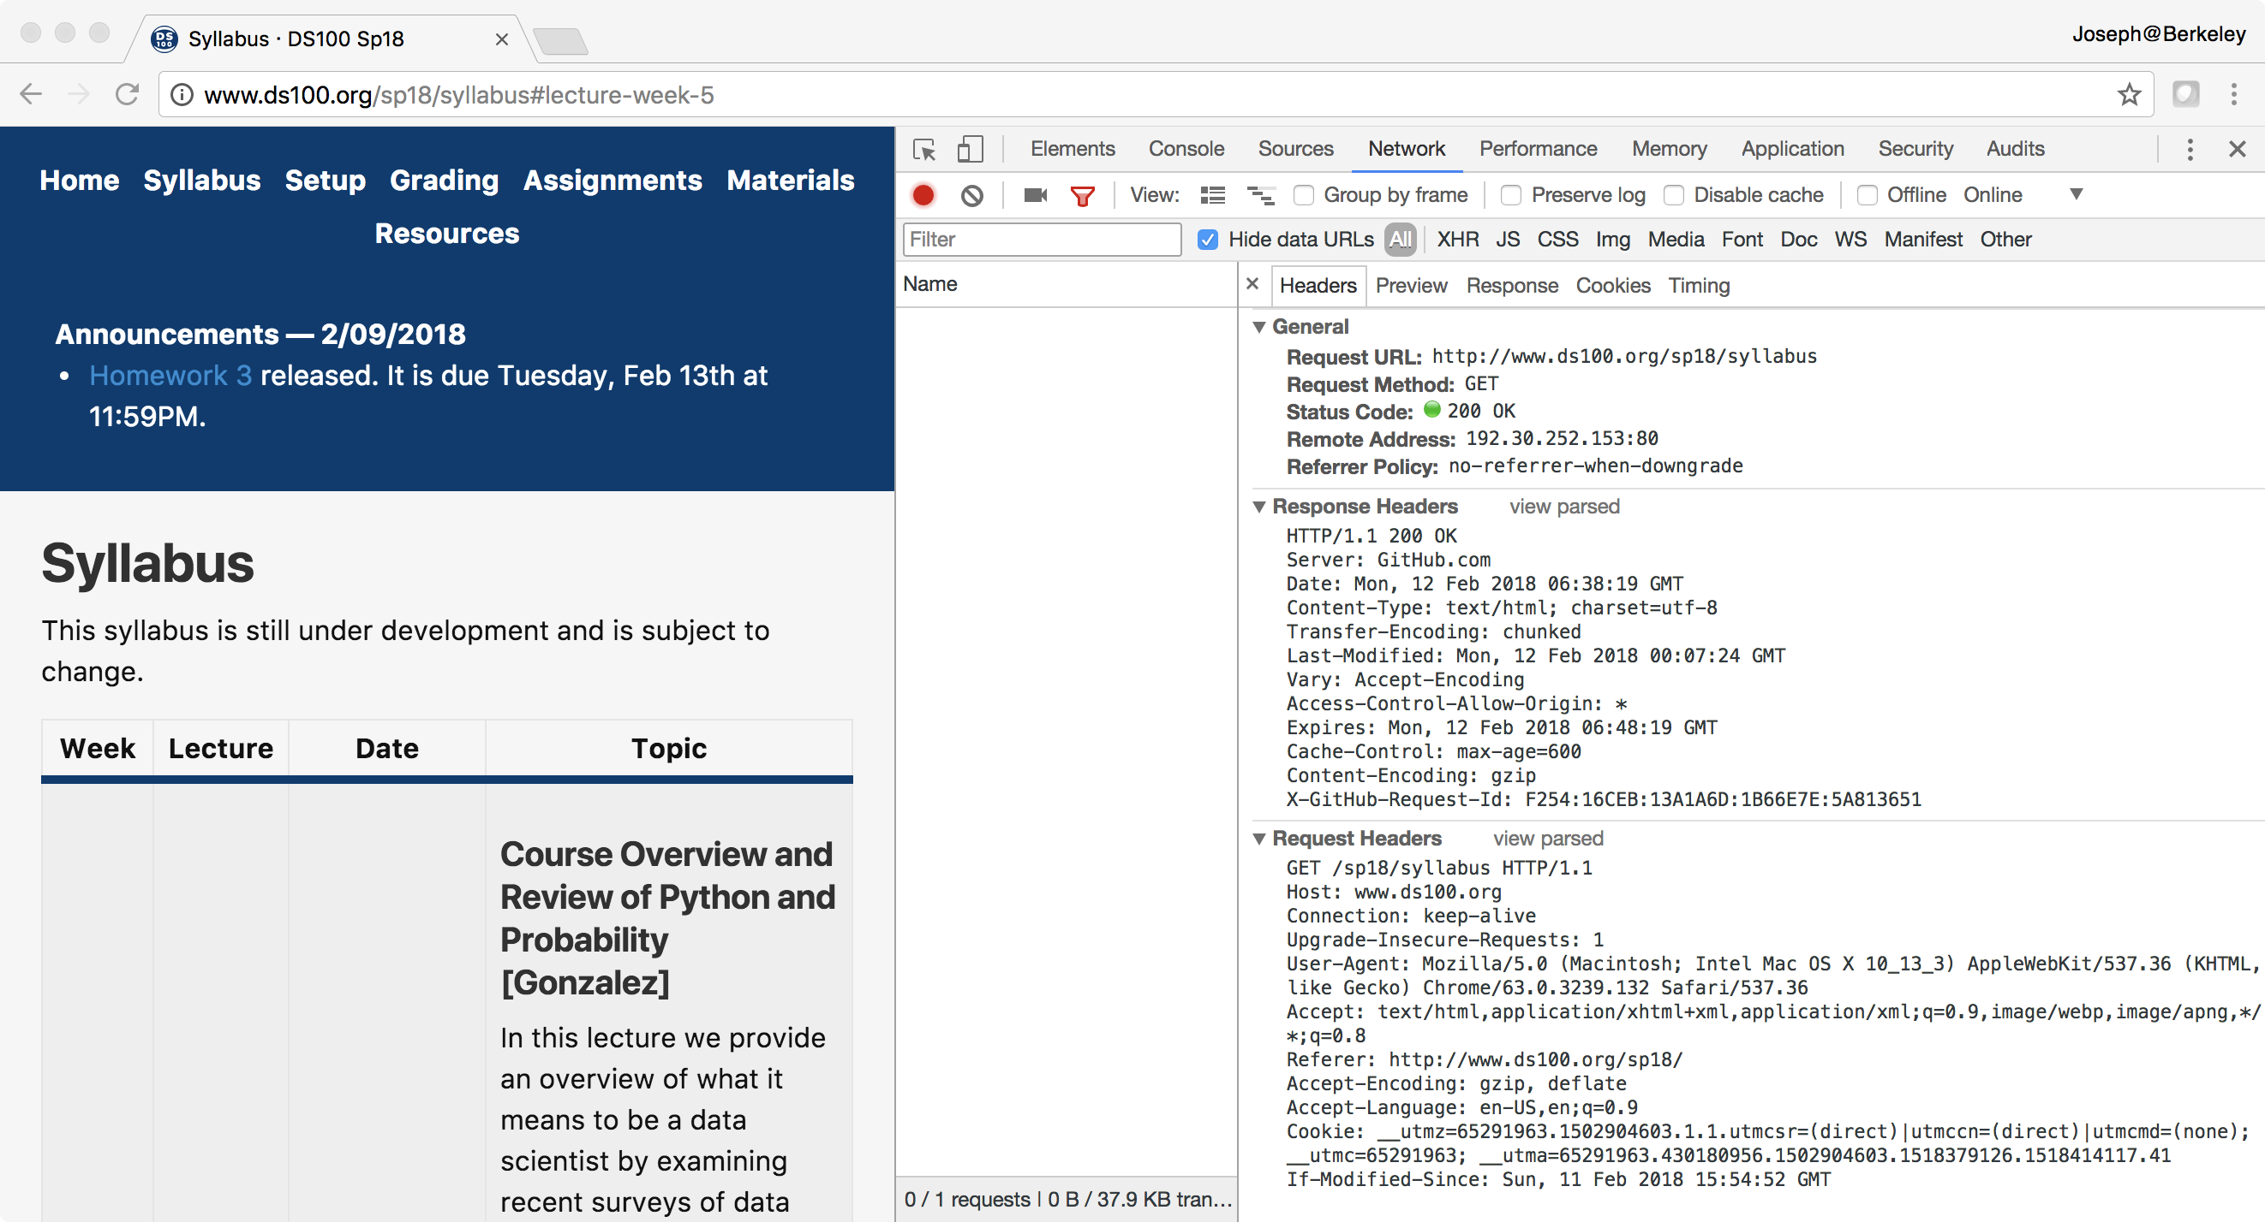
In a Web Browser
Response
Request

Slide 23
Request Types (Main Types)
GET – get information
Parameters passed in URI (limited to ~2000 characters)
/app/user_info.json?username=mejoeyg&version=now
Request body is typically ignored
Should not have side-effects (e.g., update user info)
Can be cached in on server, network, or in browser (bookmarks)
Related requests: HEAD, OPTIONS
POST – send information
Parameters passed in URI and BODY
May and typically will have side-effects
Often used with web forms.
Related requests: PUT, DELETE

Slide 24
Response Status Codes
100s Informational – Communication continuing, more input expected from client or server
200 Success - e.g., 200 - general success;
300s Redirection or Conditional Action – requested URL is located somewhere else.
400s Client Error
404 indicates the document was not found
403 indicates that the server understood the request but refuses to authorize it
500s Internal Server Error or Broken Request – error on the server side

Slide 25
HTML, XML, and JSON
data formats of the web

Slide 26
HTML/XML/JSON
Most services will exchange data in HTML, XML, or JSON
Why?
Descriptive
Can maintain meta-data
Extensible
Organization can change and maintain compatibility
Human readable
Useful for debugging and provides a common interface
Machine readable
A wide range of technologies for parsing

Slide 27
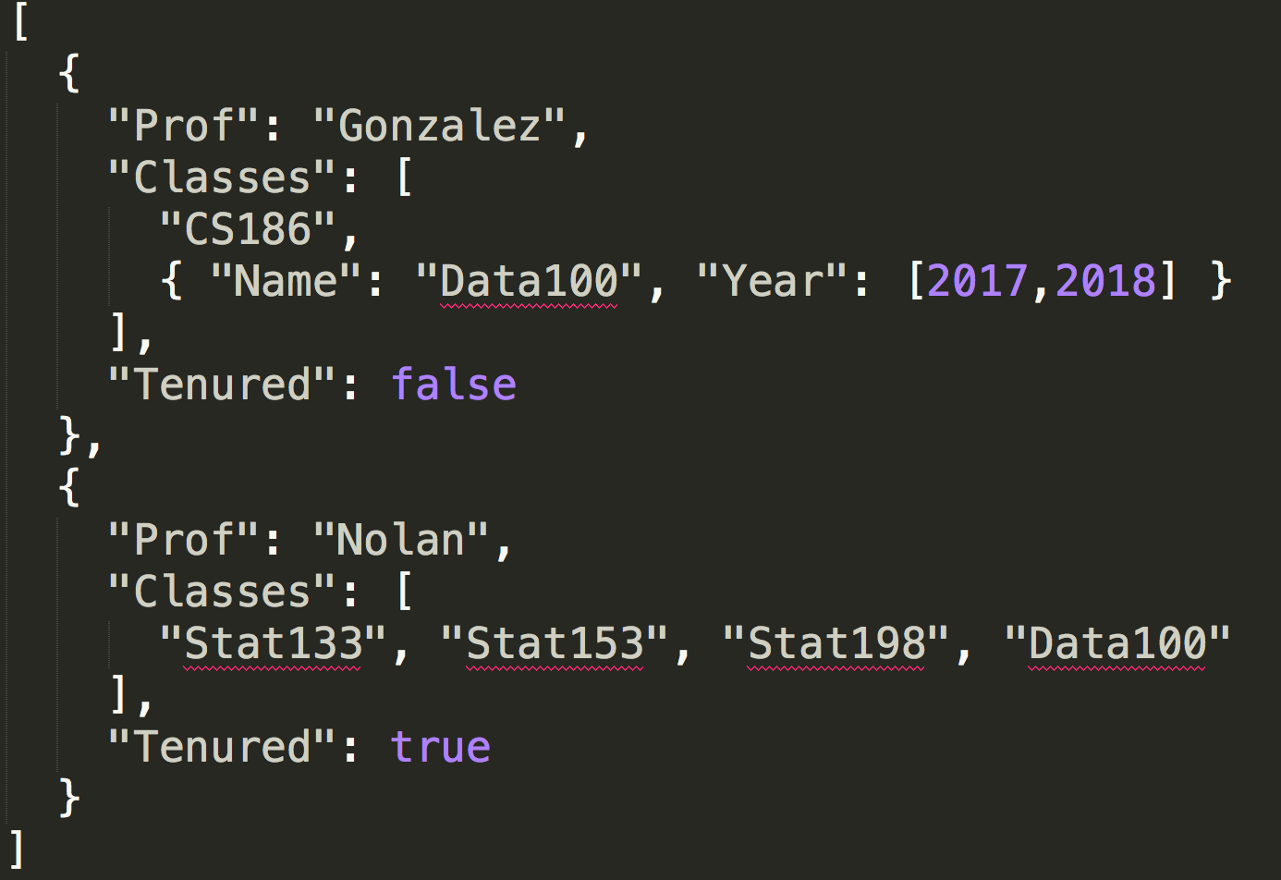
JSON: JavaScript Object Notation
Recursive datatype
Data inside of data
Value is a:
A basic type:
String
Number
true/false
Null
Array of Values
A dictionary of key:Value pairs
Demo Notebook
Basic Type (String)
[Array]
Object
“Key”: Value

Slide 28
XML and HTML
eXtensible Markup Language

Slide 29
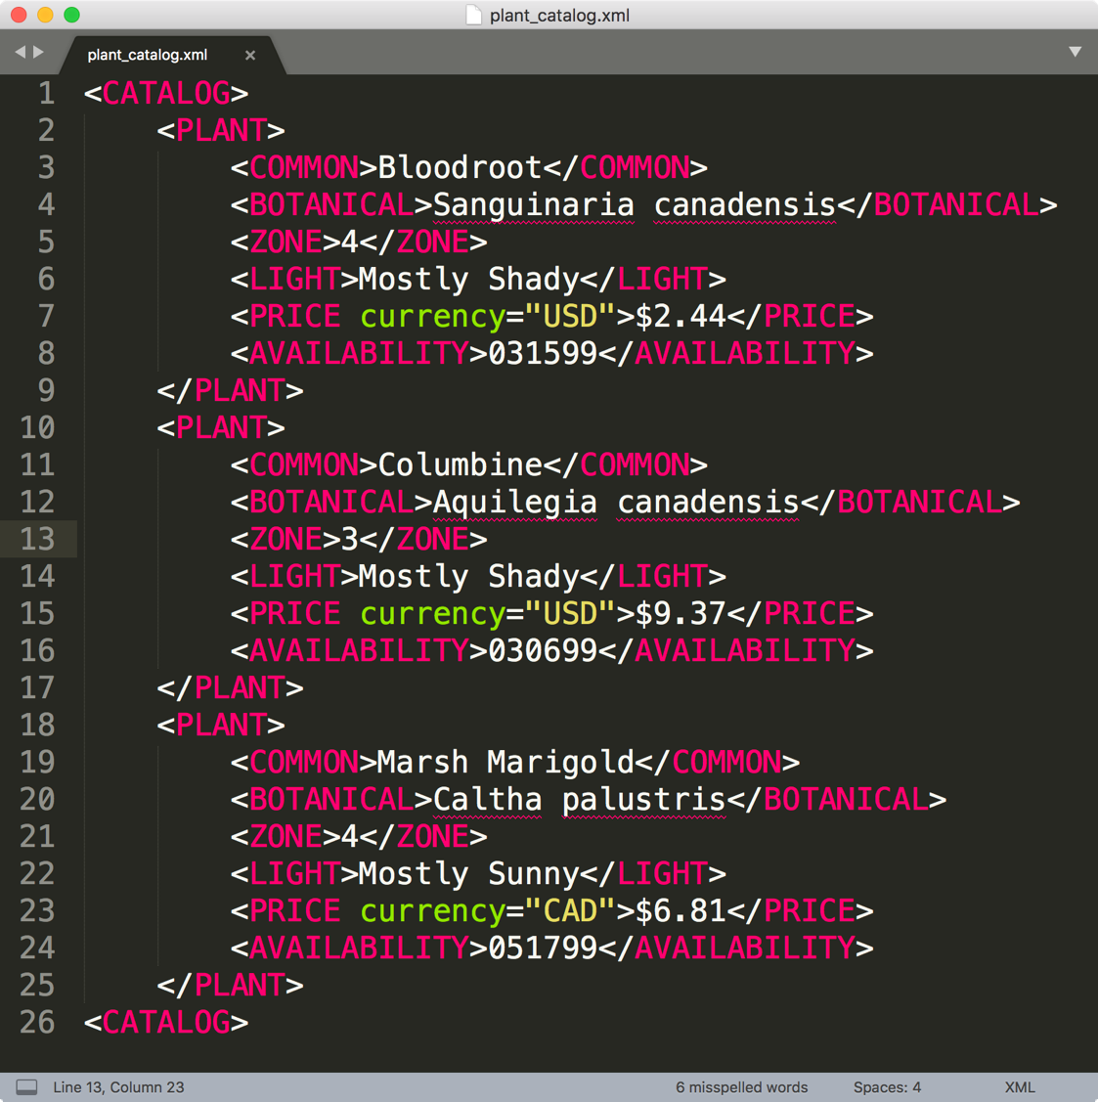
XML is a standard for semantic, hierarchical representation of data
Notes:
anything in brackets is markup; only 4 pieces of information

Slide 30
Syntax : Element / Node
The basic unit of XML code is called an “element” or “node”
Each Node has a start tag and end tag
<zone>4</zone>
Start tag
End tag
Content

Slide 31
Syntax : Nesting
A node may contain other nodes (children) in addition to plain text content.
<plant>
<zone>4</zone>
<light>Mostly Shady</light>
</plant>
Start tag
Content consists of
two nodes
Indentation is not needed. It simply shows the nesting
End tag

Slide 32
Syntax : Empty Nodes
Nodes may be empty
<plant>
<zone></zone>
<light/>
</plant>
These two nodes
are empty
Both formats are
acceptable

Slide 33
Syntax : Attributes
Nodes may have attributes (and attribute values)
<plant id='a'>
<zone></zone>
<light source="2" class="new"/>
</plant>
The attribute named type
has a value of “a”
This empty node
has two attributes:
source and class

Slide 34
Syntax : Comments
Comments can appear anywhere
<plant>
<!–- elem with content -->
<zone>4 <!–- a second comment --></zone>
<light>Mostly Shady</light>
</plant>
Two comments

Slide 35
Well-formed XML
An element must have both an open and closing tag. However, if it is empty, then it can be of the form <tagname/>.
Tags must be properly nested:
Bad!: <plant><kind></plant></kind>
Tag names are case-sensitive
No spaces are allowed between < and tag name.
Tag names must begin with a letter and contain only alphanumeric characters.

Slide 36
Well-formed XML:
All attributes must appear in quotes in:
name = "value"
Isolated markup characters must be specified via entity references. < is specified by &lt; and > is specified by &gt;.
All XML documents must have one root node that contains all the other nodes.

Slide 37
xHTML: Extensible Hypertext Markup Language
HTML is an XML-”like” structure → Pre-dated XML
HTML is often not well-formed, which makes it difficult to parse and locate content,
Special parsers “fix” the HTML to make it well-formed
Results in even worse HTML
xHTML was introduced to bridge HTML and XML
Adopted by many webpages
Can be easily parsed and queried by XML tools

Slide 38
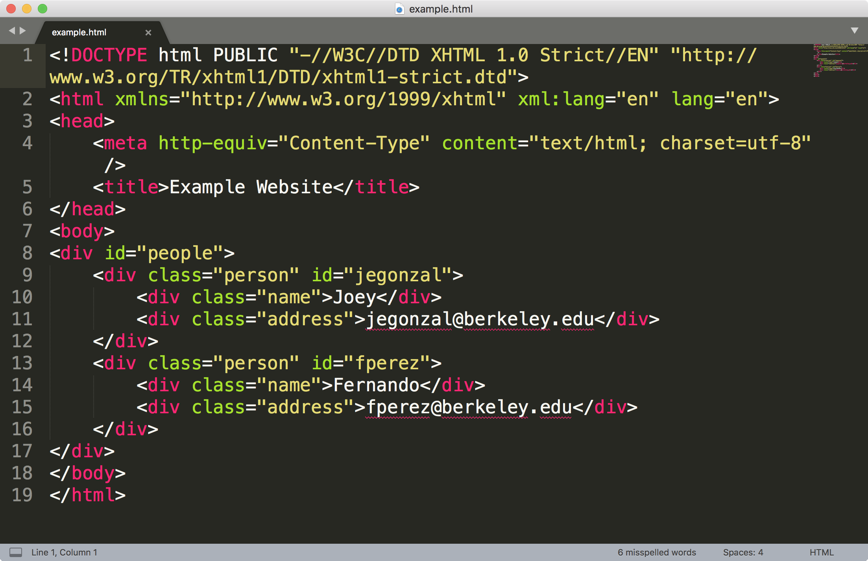
Example of well formed xHTML

Slide 39
DOM: Document Object Model
Treat XML and HTML as a Tree
Fits XML and well formed HTML
Visual containment → children
Manipulated dynamically using JavaScript
HTML DOM and actual DOM the browser shows may differ (substantially)
Parsing in Python → Selenium + Headless Chrome … (out of scope)

Slide 40
Tree terminology
There is only one root (AKA document node) in the tree, and all other nodes are contained within it.
We think of these other nodes as descendants of the root node.
We use the language of a family tree to refer to relationships between nodes.
parents, children, siblings, ancestors, descendants
The terminal nodes in a tree are also known as leaf nodes. Content always falls in a leaf node.

Slide 41
HTML trees: a few additional “rules”
Typically organized around <div> </div> elements
Hyperlinks: <a href=”uri”>Link Text</a>
The id attribute: unique key to identify an HTML node
Poorly written HTML → not always unique
Older web forms will contain forms:
<form action="/submit_comment.php" method="post"> <input type="text" name="comment" value="blank" /> <input type="submit" value="Submit" /> </form>
See notebook for demo on working with forms …

Slide 42
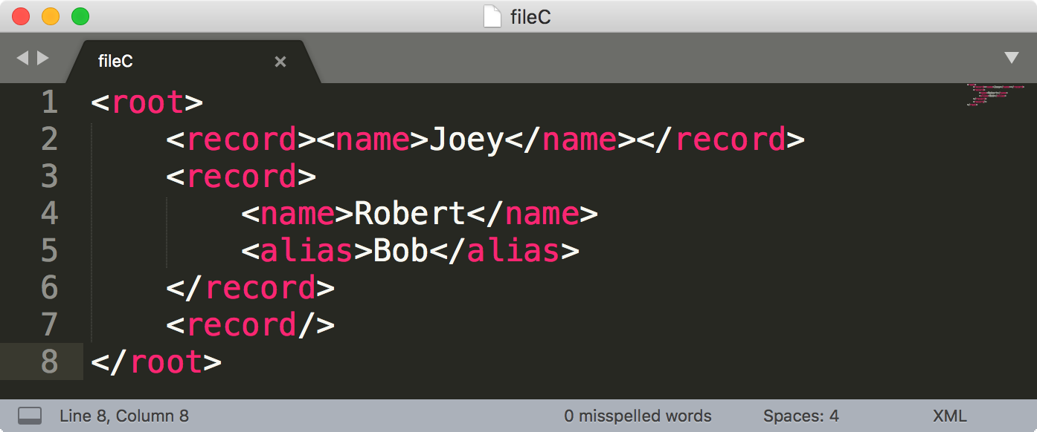
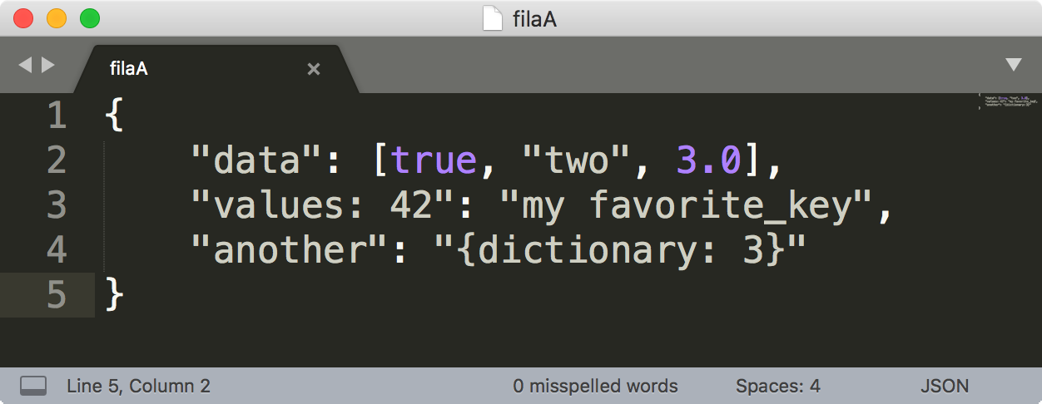
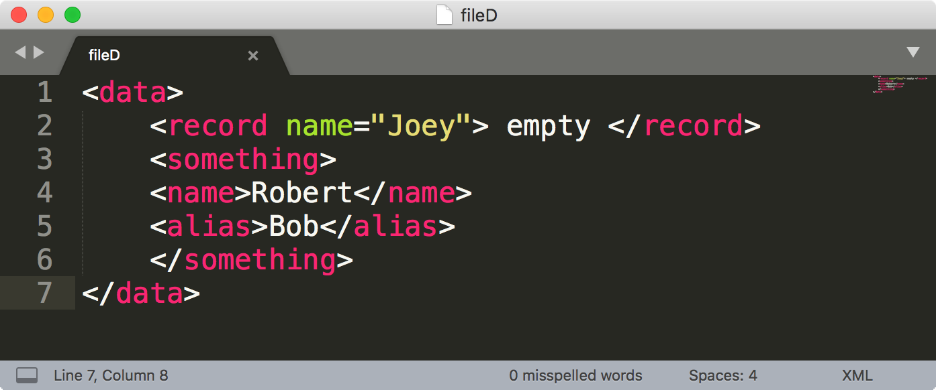
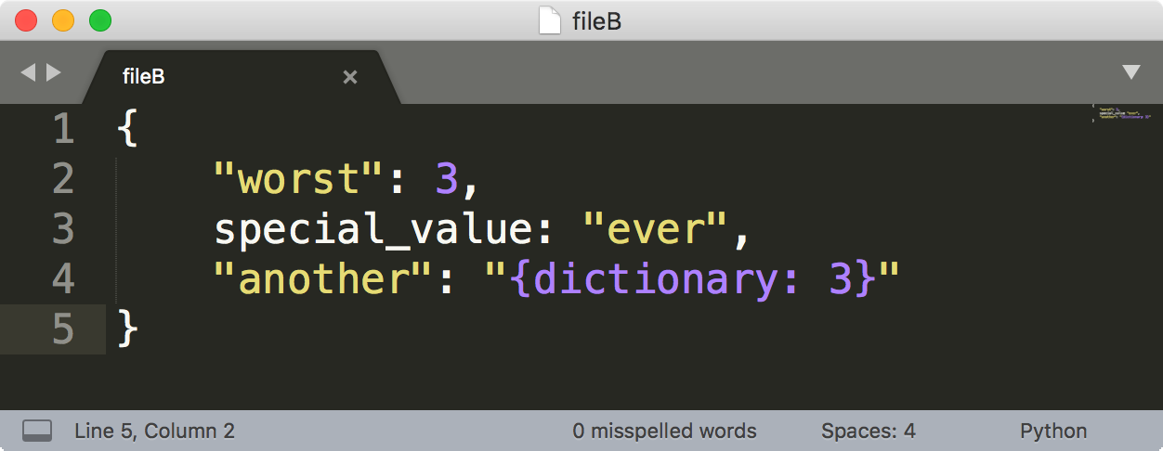
Which files are broken?
http://bit.ly/ds100-sp18-xml
fileC.xml
FileA.json
fileD.xml
FileB.json

Slide 43
Next lecture Regex
Staring Sam Lau
We will finish REST and HTTP on Tuesday

